Slide 1

Project NLP | Business Case: Automated Customer Reviews
Abdulaziz Alshehri Bader Albehishi Amjad Aloufi

Slide 2

Overview
Project objective
Review Classification
Product Category Clustering
Review Summarization
Deployment

Slide 3

Project objective
Develop a product review system powered by NLP modelsthat can achieve:
. Classification reviews
. Clustering categories
. Summarizing customers reviews

Slide 4
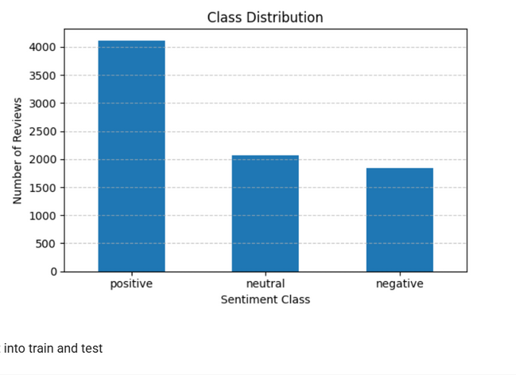

Review Classification
Three files have been merged to get:
To balance data
oversampling
class weight
positive 4115
neutral 2063
negative 1842
before split and after remove dubliction

Slide 5
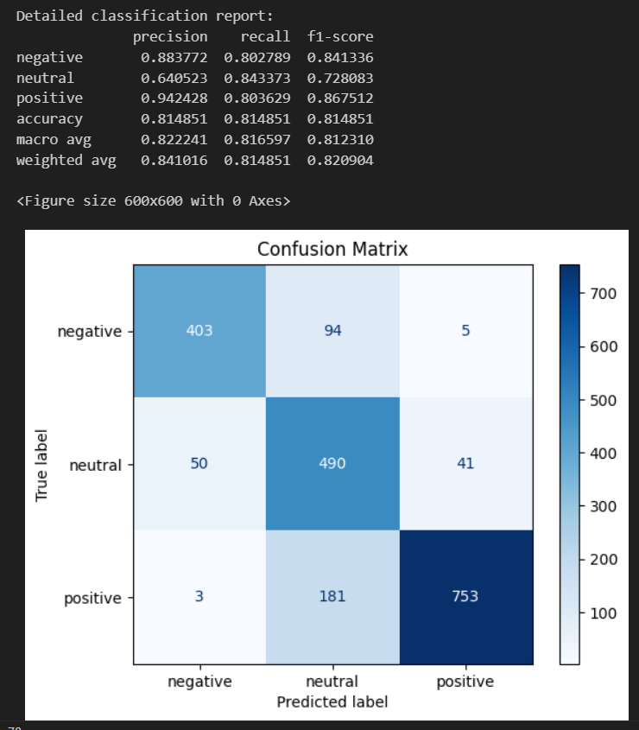
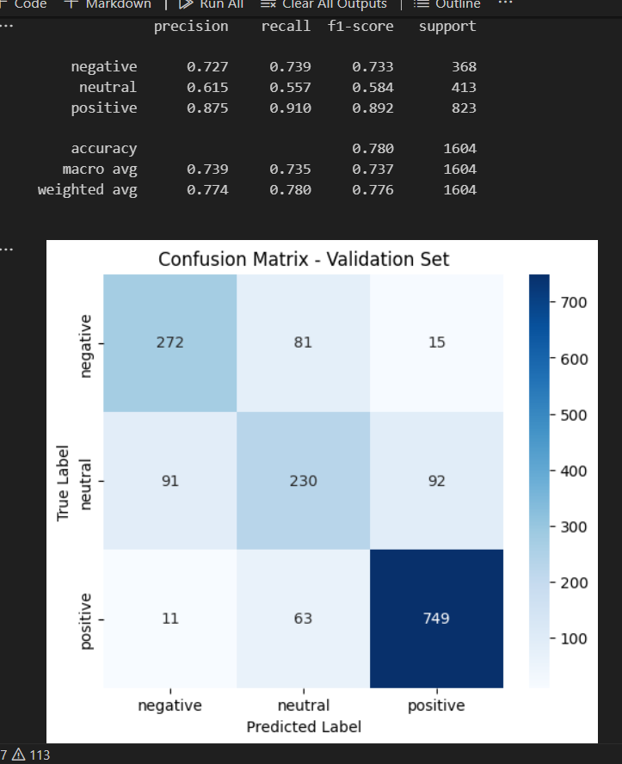
class weight oversampling
No overfitting; the difference between the training and testing was little (roberta-base)

Slide 6
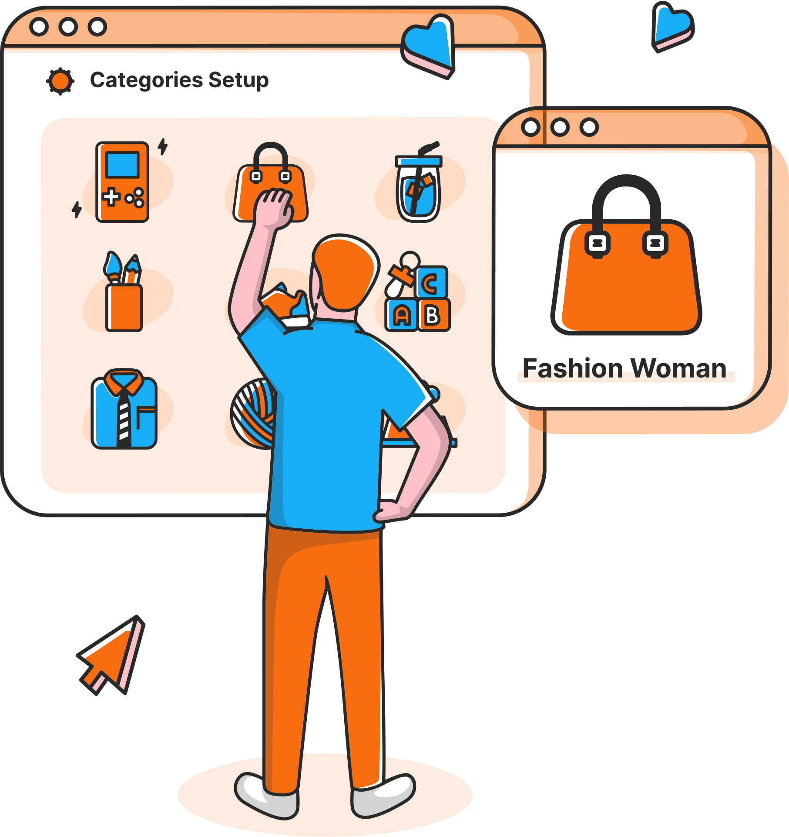
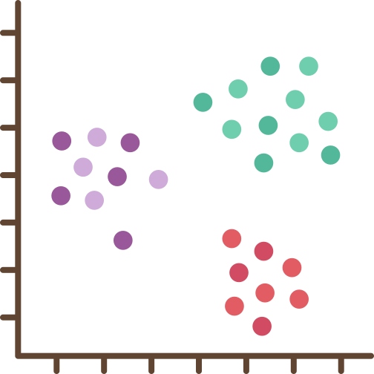
Product Category Clustering
Group product reviews into 4–6 high-level meta-categories to simplify analysis and improve insight extraction.

Slide 7








Data preprocessing
Load the dataset
Combine features
Remove stopwords
Data cleaning

Slide 8
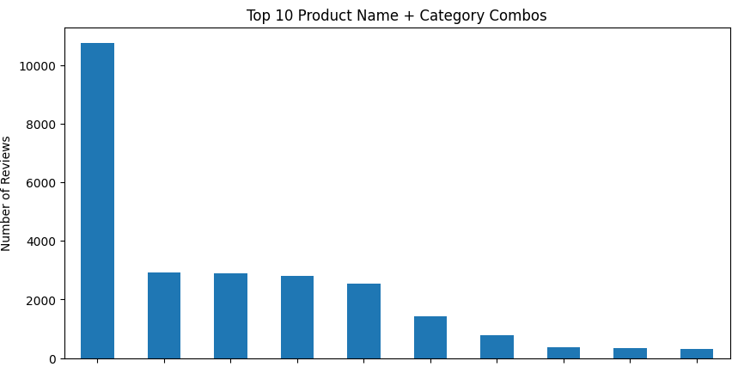

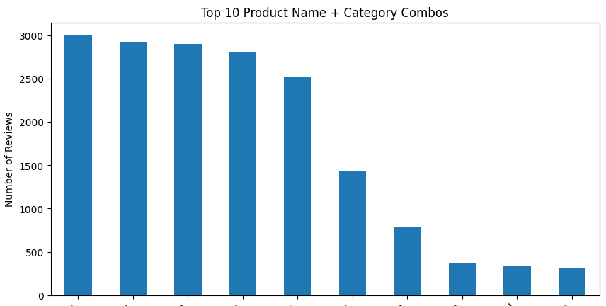
Data Balancing
using Undersampling

Slide 9




Embedding and Clustering
SentenceTransformer (all-MiniLM-L6-v2) to embed the cleaned text.
Applies HDBSCAN cluster on the embeddings to group similar reviews.

Slide 10

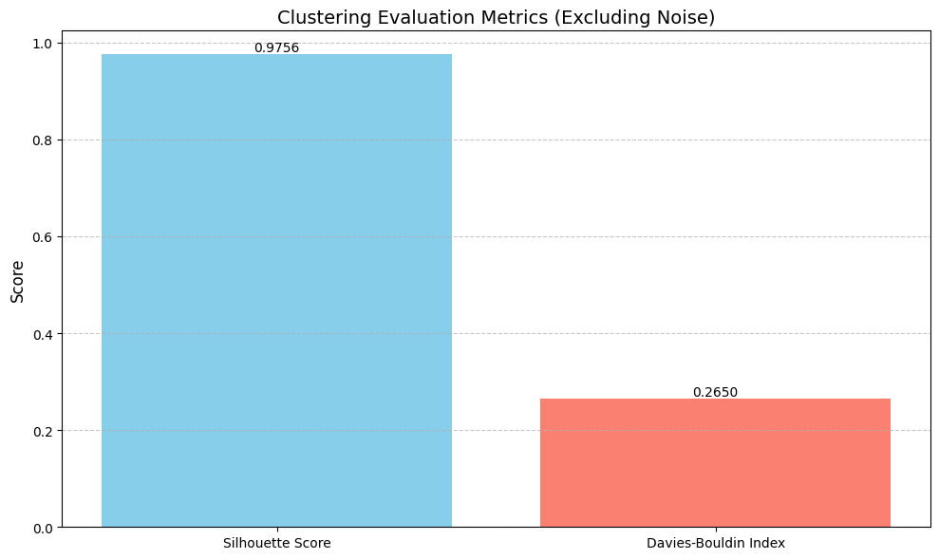
Clustering Metrics Evaluation

Slide 11

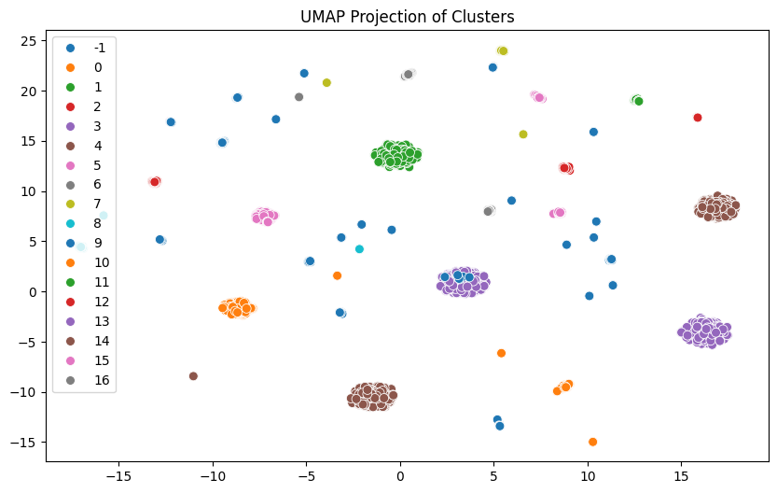
UMAP visualization

Slide 12

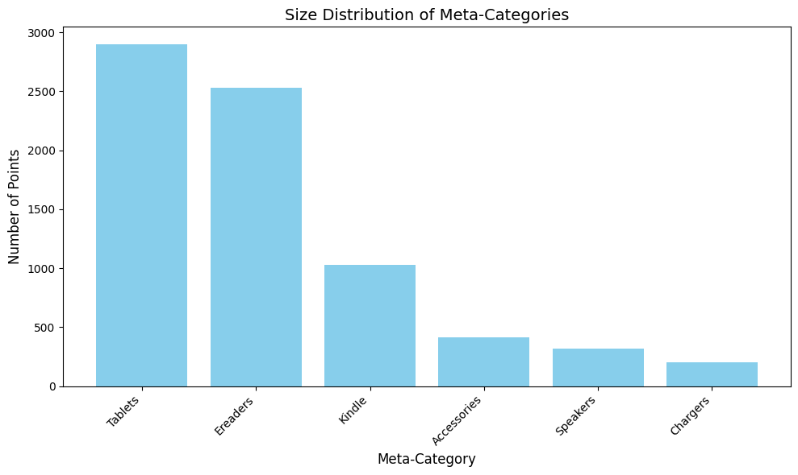

Naming Meta-category using GPT
Extracts the top keywords
prompt to OpenAI GPT

Slide 13

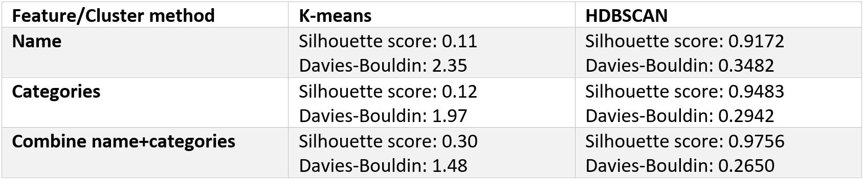
Limitations and Challenges:

Slide 14

Review Summarization Using Generative AI
create article-style summaries that provide recommendations for the top products in various categories based on customer reviews.

Slide 15





Data preprocessing
Product Name | Categories
review text | review rating
Calculate the average
rating preproduct
Collect Samples from the reviews

Slide 16

Prompt
Prorompt using GPT-3.5-Turbo
Prompt includes
The product category name
Top and worst 3 products with sample review snippets each.
Narrative-style blog article (~200 words)
Storytelling tone

Slide 17

Deployment

Slide 18

The End
Thank you for listening!
Q&A?

